Slide 1



COMPONENT DIAGRAMM TEMPLATE

Slide 2
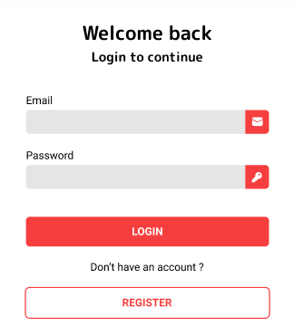
Sign in Component Diagram
Emit
<app>
<log-in>
user
Users
WHAT WILL HAPPENED:
Compare or check of email, and password match to the information that we signed before.
If email and pass don’t match, cannot login.

Slide 3
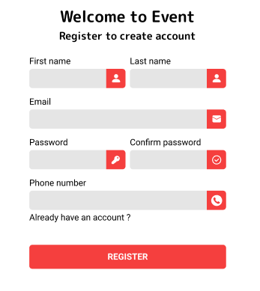
Sign up Component Diagram
Emit
<app>
<register>
user
Users
WHAT WILL HAPPENED:
Check if the validation doesn’t match or doesn’t have in the data (new user).
Need to confirm password if the confirm pass match to the password, then we can register

